Slide 1
Ecological Problems

Slide 2

Since ancient times Nature has served Man, being the source of his life. For thousands of years people lived in harmony with environment and it seemed to them that natural riches were unlimited. But with the development of civilization man's interference in nature began to increase.

Slide 3
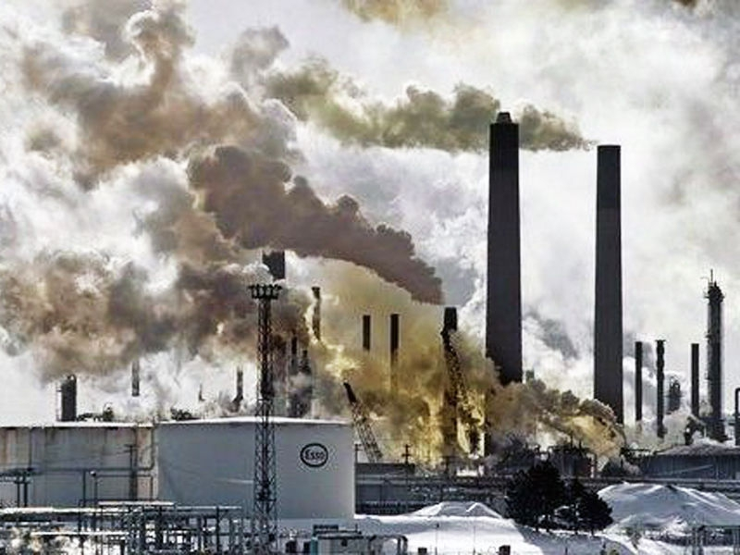
Large cities with thousands of smoky industrial enterprises appear all over the world today. The by-products of their activity pollute the air we breathe, the water we drink, the land we grow grain and vegetables on.

Slide 4
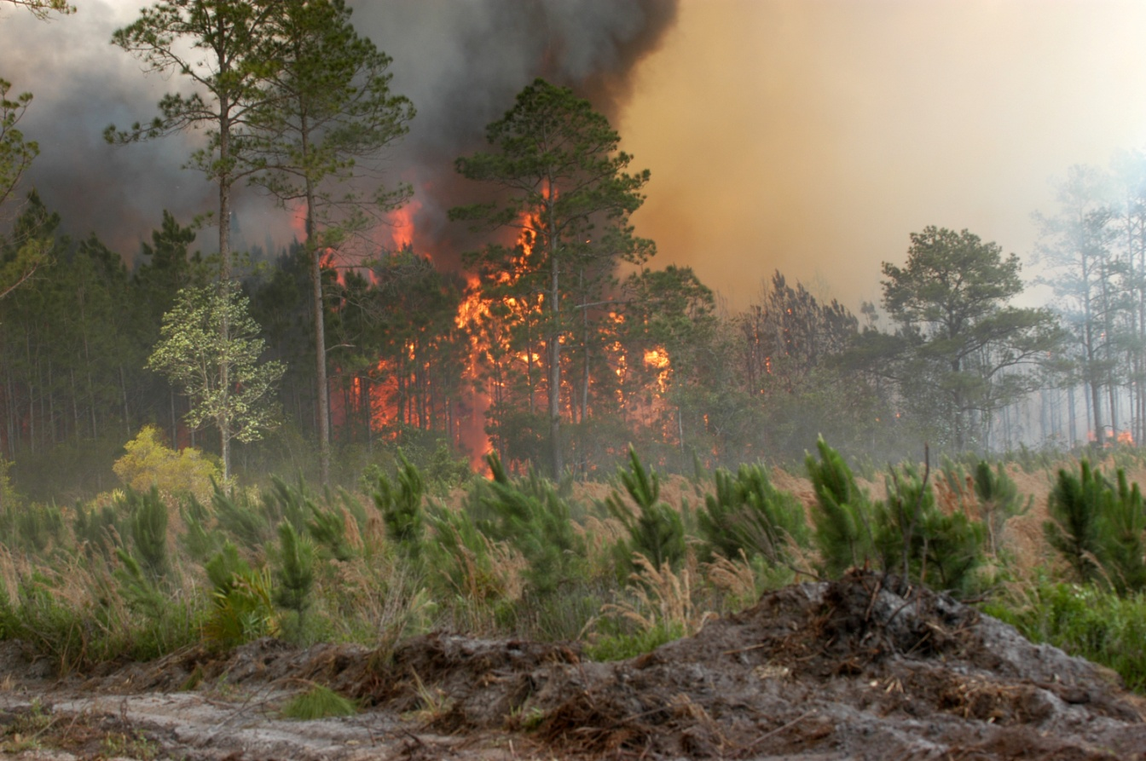
Every year world industry pollutes the atmosphere with about 1000 million tons of dust and other harmful substances. Many cities suffer from smog. Vast forests are cut and burn in fire. Their disappearance upsets the oxygen balance. As a result some rare species of animals, birds, fish and plants disappear forever, a number of rivers and lakes dry up.

Slide 5
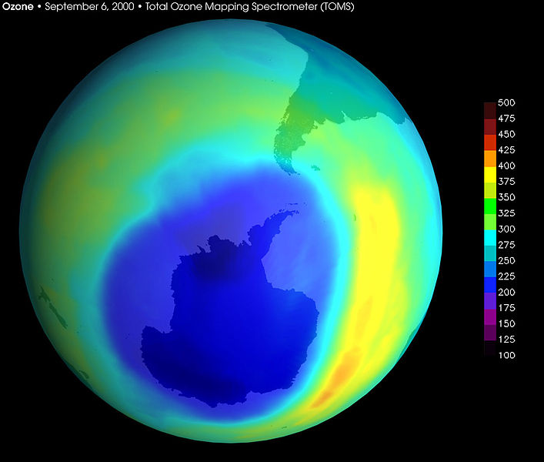
The pollution of air and the world's ocean, destruction of the ozone layer is the result of man's careless interaction with nature, a sign of the ecological crises.

Slide 6
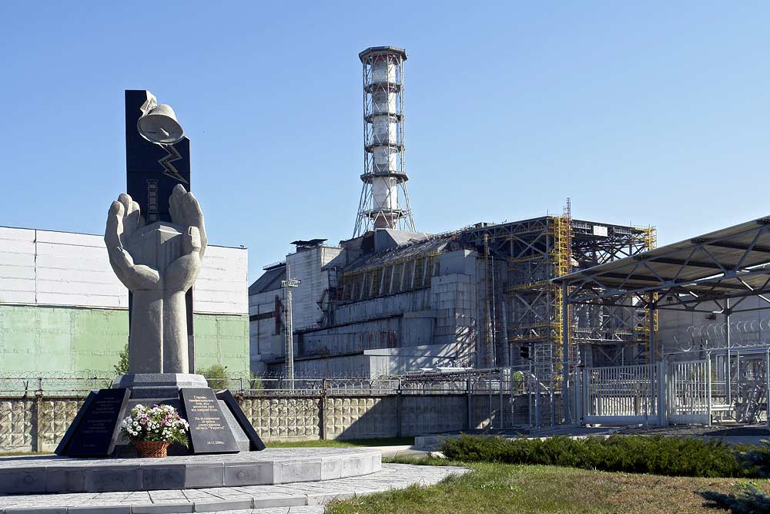
The most horrible ecological disaster befell Ukraine and its people after the Chernobyl tragedy in April 1986. About 18 percent of the territory of Byelarus were also polluted with radioactive substances. A great damage has been done to the agriculture, forests and people's health. The consequences of this explosion at the atomic power-station are tragic for the Ukrainian, Byelorussian and other nations.

Slide 7

Environmental protection is of a universal concern. That is why serious measures to create a system of ecological security should be taken.

Slide 8

Some progress has been already made in this direction. As many as 159 countries — members of the UNO — have set up environmental protection agencies. Numerous conferences have been held by these agencies to discuss problems facing ecologically poor regions including the Aral Sea, the South Urals, Kuzbass, Donbass, Semipalatinsk and Chernobyl.

Slide 9

The international organisation Greenpeace is also doing much to preserve the environment.

Slide 10
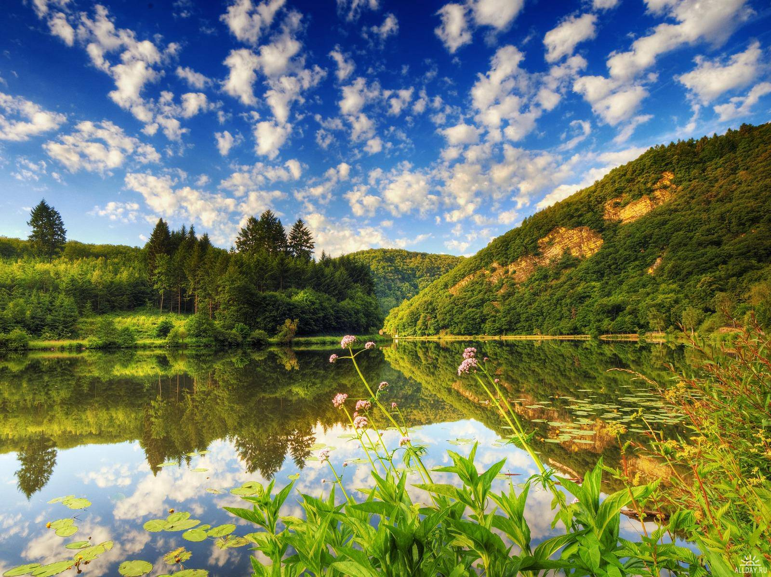
But these are only the initial steps and they must be carried onward to protect nature, to save life on the planet not only for the sake of the present but also for the future generations.

Slide 11
The end
Prepared Nagorna Daria

Slide 12
That environmental problems badly influence of nature?
That the tragedy occurred in the spring of 1986?
Which organization dedicated to the protection of nature in the world?
What we can do for nature conservation?

Slide 13
